Slide 1
ECEN 150 Circuit Analysis I
Operational Amplifiers

Slide 2
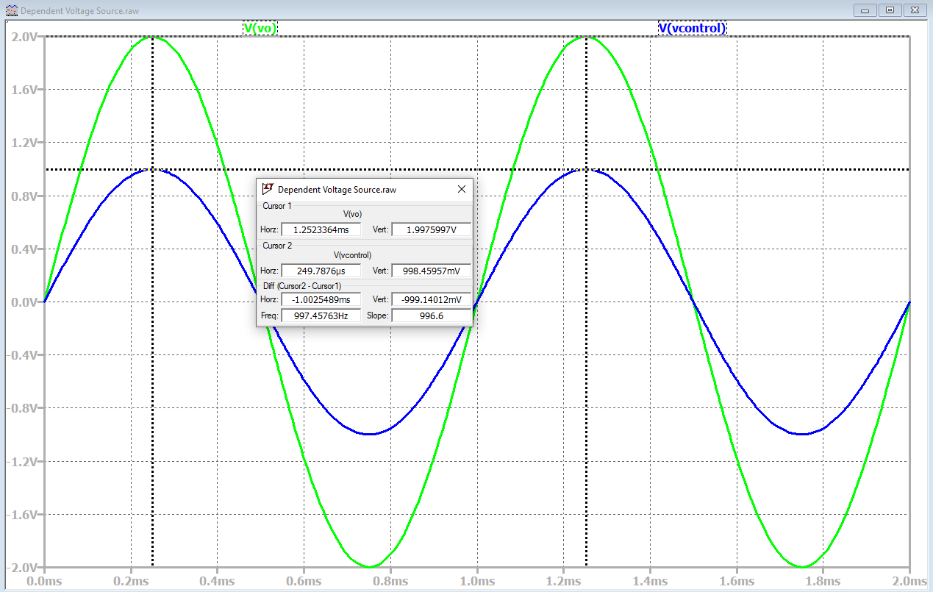
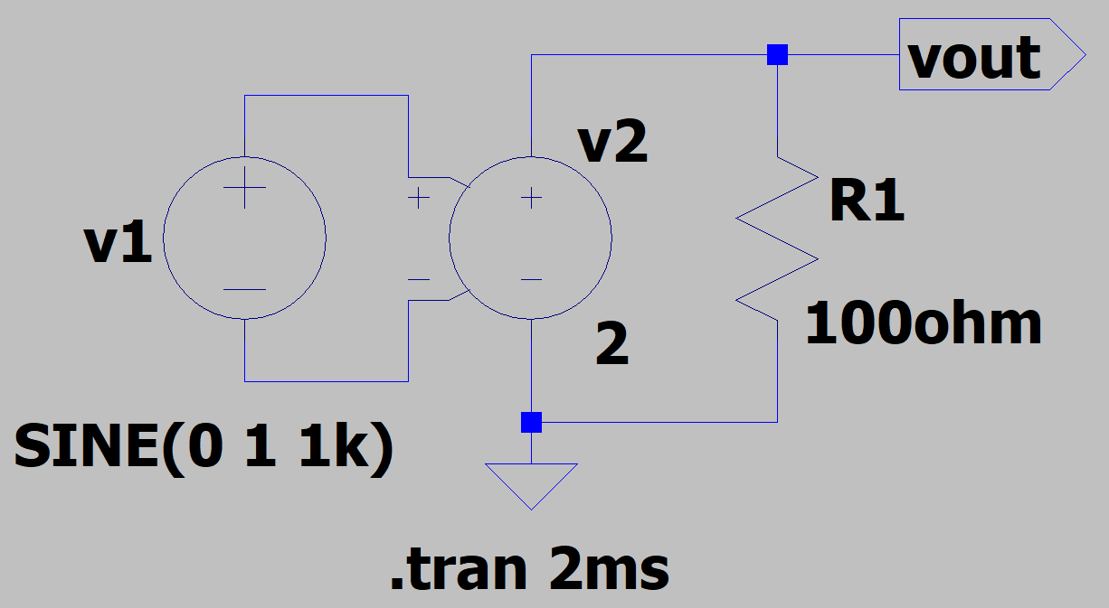
Voltage-Dependent Voltage Source
Voltage-dependent voltage source to use in the LTspice Voltage and Current Source Lab.
Dependent voltage source v₂ in the schematic below has a voltage gain A_{V} = 2.
Hence, v_{out} = 2v₁.
An example of a practical voltage-dependent
voltage source is an audio amplifier.

Slide 3
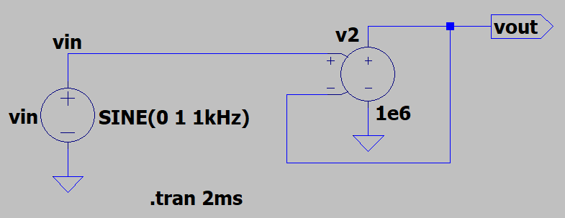
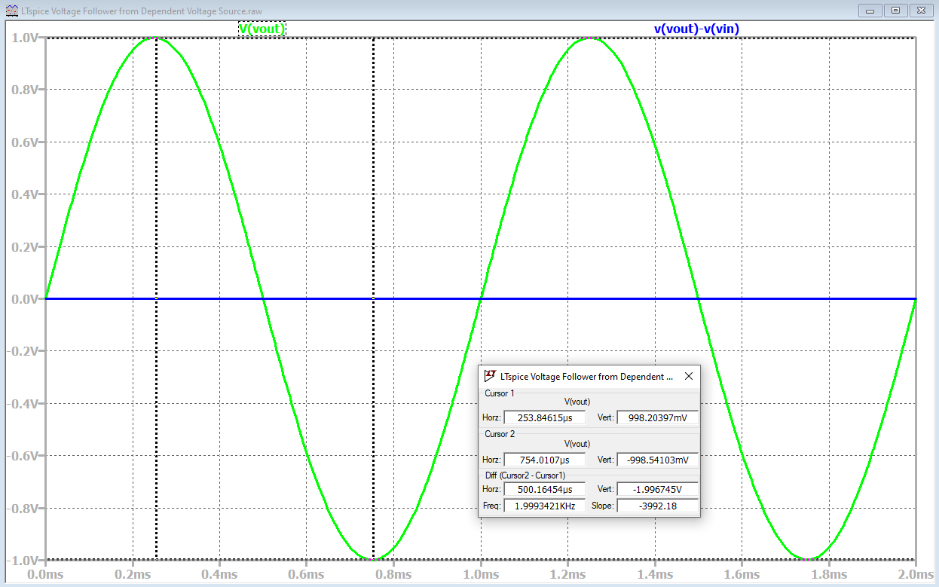
Feedback Control
Large gain voltage-dependent voltage source with negative
feedback, meaning that output voltage is fed back to minus input
of the dependent voltage source.
The resulting output voltage follows the input voltage,
while requiring no input current.
The large multiplier of 1e6, (1 x 10⁶), along with v_{out} connected
to the minus input, referred to as negative feedback,
results in v_{out} almost exactly equalling v_{in}.
The resulting circuit is constantly adjusting the voltage
on the minus input towards the voltage on the plus input,
referred to as feedback control.
Where else is feedback control used?
Cruise control, building heating and air conditioning,
oven temperature control, etc. ECEN 470 – “Feedback
Control of Dynamic Systems” covers important details.

Slide 4
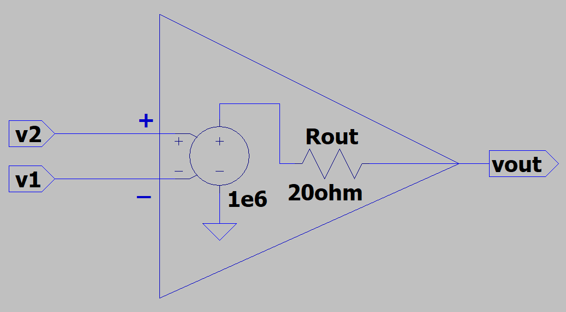
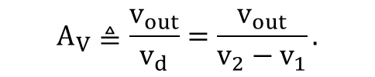
Operational Amplifier – Op-Amp
Voltage-dependent voltage source with large open-loop voltage gain A_{V} = 1e6 in the circuit below.
Voltage gain is referred to a simply A in our text. So the text A equals the voltage gain A_{V} in these slides, where the subscript V indicates voltage versus current gain.
What does voltage gain A_{V} mean?
A_{V} is referred to as open-loop gain, when there is no output feedback.
Op-amps are most useful, with output feedback to the minus input, i.e., negative feedback.
Plus and minus inputs sense voltage, but require no
input current.
Relatively small R_{out}.
The voltage-dependent voltage source is simply
an equivalent model for the many transistors that are
used to construct real op-amps.
$$A_{V}≜\frac{v_{out}}{v_{d}}=\frac{v_{out}}{v_{2}−v_{1}}.$$

Slide 5
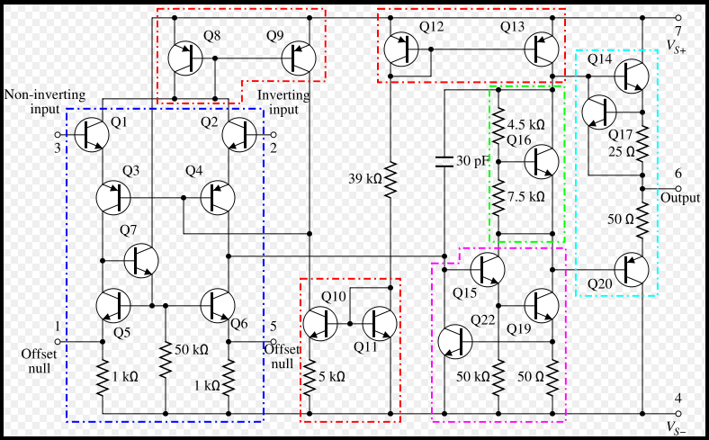
Classic 741 Op-Amp
A component-level diagram of the common 741 op-amp. Dotted lines outline: current mirrors (red); differential amplifier (blue); output gain stage (magenta); voltage level shifter (green); emitter-follower output stage (cyan).

Slide 6
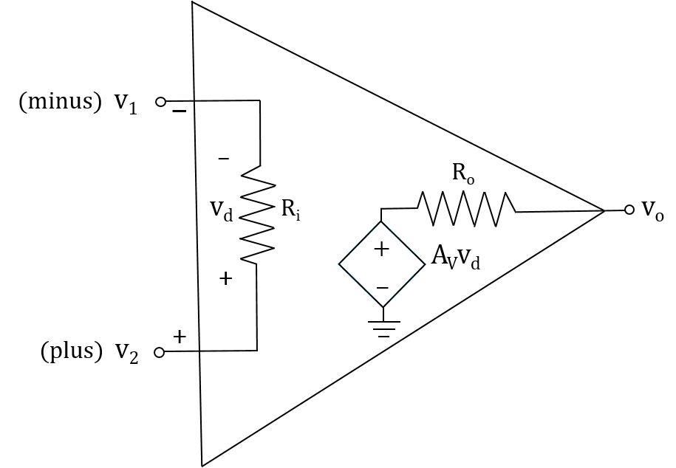
Operational Amplifier – Op-Amp
Op-amp → Active circuit element designed to perform the mathematical operations of addition, subtraction, multiplication, division, differentiation and integration.
Name Operational comes from analog computer days in which op-amps and other components were used to implement mathematical operations.
Op-amps behave like a voltage-controlled voltage-source.
An op-amp output is governed by the voltage difference between the + and - inputs.
v_{p} - v_{m}, where A_{V} is the open-loop voltage gain.
A_{V} > 100,000 for most op-amps.

Slide 7
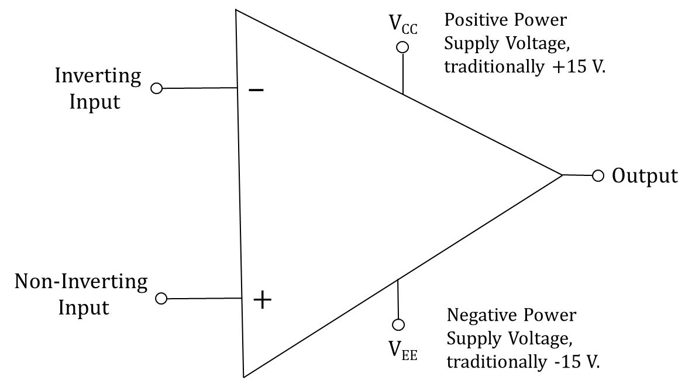
Op-Amps (Continued)
Because of the large open-loop voltage
gain, if the voltage on the non-inverting input
is slightly greater than the voltage on the
inverting input, then the output will increase
in voltage towards V_{CC}.
Likewise, if the voltage on the inverting input
is slightly greater than the voltage on the non-inverting input,
then the output will decrease in voltage towards V_{EE}.
v_{o}= A_{V}v_{d} =A_{V}(v_{p} – v_{m}). (Open loop)
A_{V} > 100,000 for most op-amps.
Op-amp output is governed by the voltage difference between the + and - inputs.

Slide 8
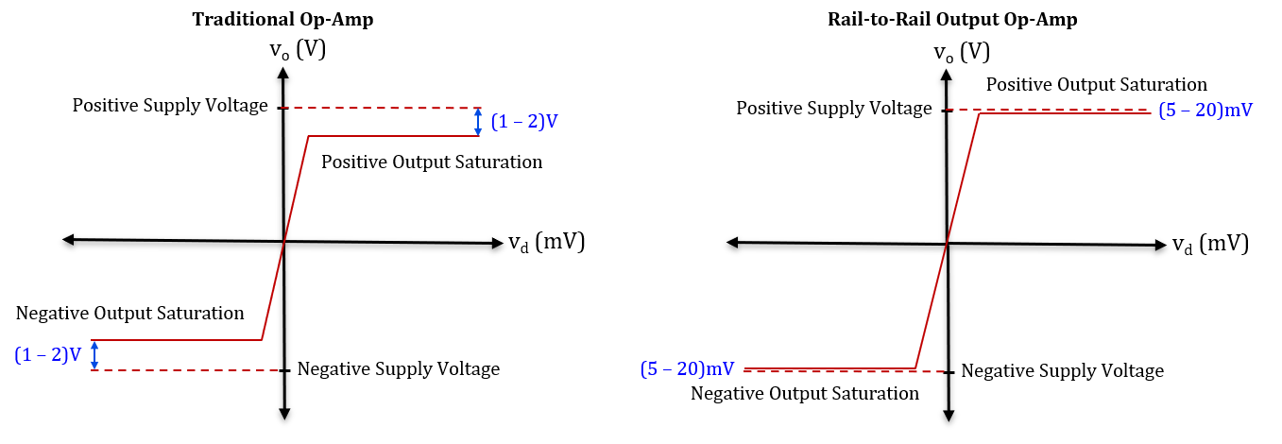
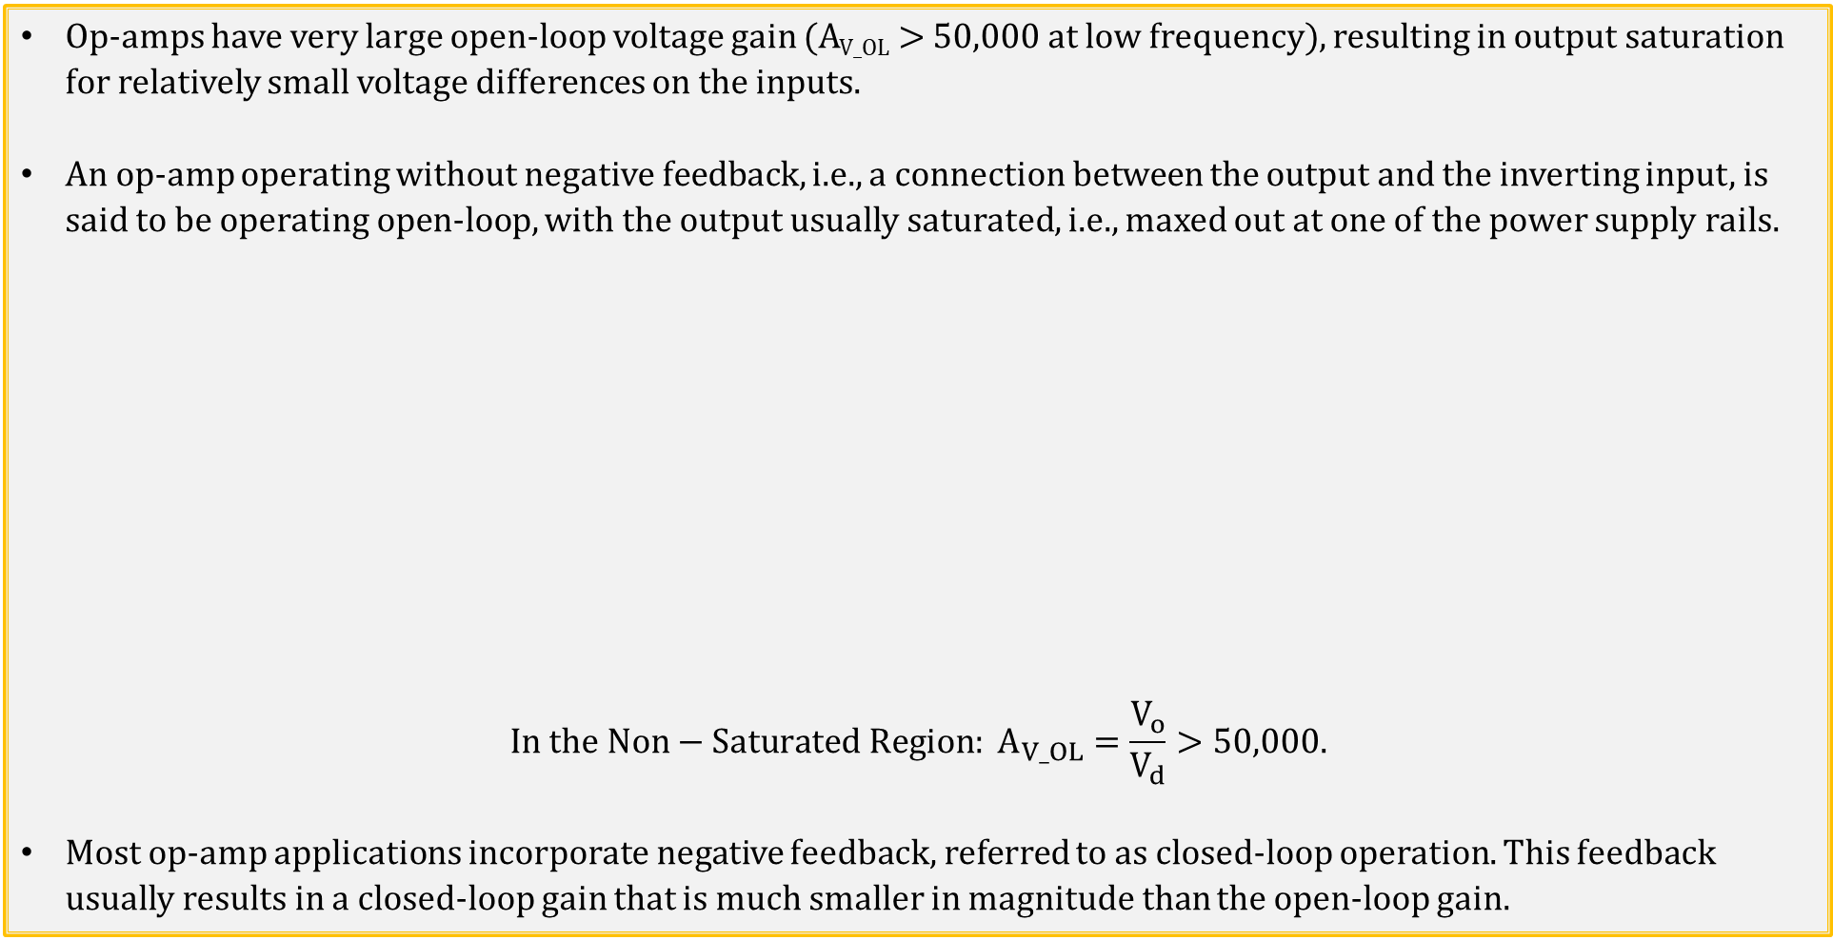
Op-Amps (Continued)
Op-amps have very large open-loop voltage gain (A_{V_OL} > 50,000 at low frequency), resulting in output saturation for relatively small voltage differences on the inputs.
An op-amp operating without negative feedback, i.e., a connection between the output and the inverting input, is said to be operating open-loop, with the output usually saturated, i.e., maxed out at one of the power supply rails.
$$In the Non−Saturated Region: A_{V_OL}=\frac{V_{o}}{V_{d}}>50,000.$$
Most op-amp applications incorporate negative feedback, referred to as closed-loop operation. This feedback usually results in a closed-loop gain that is much smaller in magnitude than the open-loop gain.

Slide 9
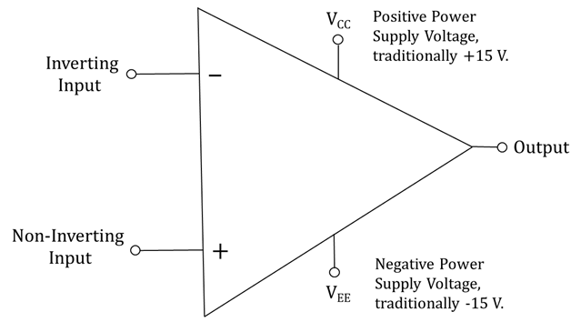
Ideal Op-Amps
An ideal op-amp utilizes the following three assumptions, commonly used for hand calculations:
1. Infinite open-loop gain, i.e., A_{V} = ∞.
2. Infinite input resistance, meaning current into the two input terminals equals 0.00 µA.
3. Zero output resistance, which is the assumption made for an ideal voltage source.
Modern practical op-amps are close enough to ideal that the above ideal op-amp assumptions give good results for most hand calculations.
Parameter | Typical Range | Ideal Values
Open-Loop Voltage Gain, A_{V} | 10⁵ to 10⁸ | ∞
Input Resistance, R_{i} | 10⁵ to 10¹³ Ω | ∞ Ω
Output Resistance, R_{o} | 10 to 100 Ω | 0 Ω
Supply Voltage Range (V_{CC} – V_{EE}) | 5 V to 30 V | Any Value

Slide 10
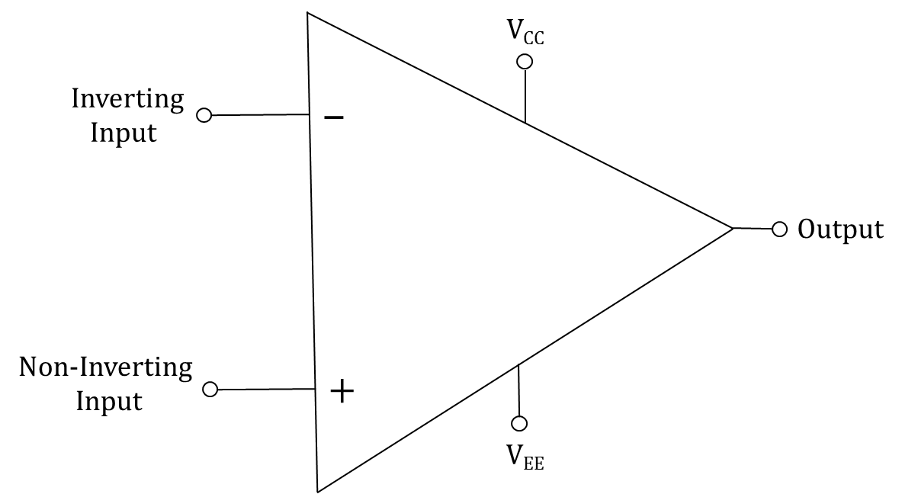
Ideal Op-Amps (Continued)
Ideal op-amp assumptions for Hand Calculations:
1. Infinite open-loop voltage gain.
2. Infinite input resistance, meaning current into the two input terminals equals 0 A.
3. Zero output resistance, which is the assumption made for an ideal voltage source.
4. When negative feedback is incorporated, we assume that the voltage difference between the inverting
and non-inverting inputs equals 0 V.
So for hand calculations assume current flowing into the inverting and non-inverting input both equal zero, which is helpful.
Also assume the output resistance is zero, i.e., R = R_{s} = R_{th} = 0, which is also helpful.
An additional ideal op-amp assumption is that when negative feedback is incorporated we assume that the voltage difference between the inverting and non-inverting inputs equals 0 V.
Negative feedback means a wire or component like a resistor connected between the output and the inverting (minus) input.

Slide 11
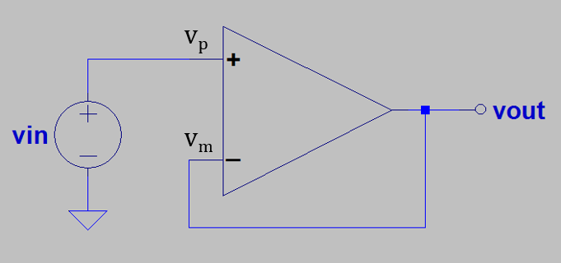
Ideal Voltage Follower
For the adjacent voltage follower circuit, with v_{p} = v_{in} and v_{m} = v_{out},
what can we say about voltages on the non-inverting, v_{p},
and inverting, v_{m} inputs?
Because of very large open-loop voltage gain, along with the output
connected to the inverting input, v_{out} always adjusts v_{m} towards v_{p}.
If v_{out} became < v_{in} , then v_{p} > v_{m} resulting in v_{out} increasing v_{m} until v_{m} again equals v_{p}.
If v_{out} became > v_{in}, then v_{p} < v_{m} resulting in v_{out} decreasing v_{m} until v_{m} again equals v_{p}.
The only time that V_{out} is not adjusting V_{m} towards V_{p}, is when V_{m} = V_{p}, which implies V_{out} = V_{in}. Hence, V_{out} follows V_{in}.
The further away V_{m} is from V_{p}, the more forcefully V_{out} adjusts V_{m} towards V_{p}.
The closer V_{m} is to V_{p}, the less forcefully V_{out} adjusts V_{m} towards V_{p}.
For feedback-control applications, negative feedback is a wonderful idea.
Since v_{out} = v_{in}, the resulting voltage gain with feedback, i.e., closed-loop gain, equals 1 because of negative feedback, whereas open-loop gain >> 1, where >> means much greater than.

Slide 12
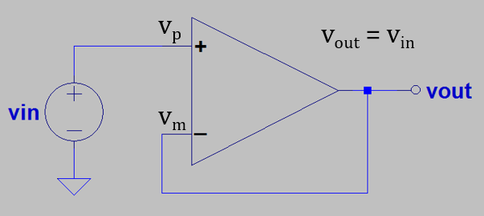
Feedback Control
Feedback control: Inverted Pendelum
Feedback control is used to keep the bottom (-) end of the pendulum in vertical alignment with the top (+) end, with the controller constantly minimizing any difference. As a result, the bottom (-) end follows the vertical position of the top (+) end of the inverted pendulum. The horizontal corrective response of the controller has to be larger than any misalignment to keep the pendelum inverted, making large horizontal gain and quick response time desirable. The larger the vertical mis-alignment, the larger the corrective response to minimize the misallignment.
Feedback control: Voltage Follower
Feedback control is used to keep the minus (-) input of the op-amp equal to the plus (+) input, with the op-amp output constantly minimizing any difference. As a result, the minus (-) input follows the voltage of the plus (+) input of the op-amp when the output is connected to the minus (-) input, referred to as negative feedback. The corrective response of the op-amp has to be larger than any |v_{p} - v_{m}|, for the output to follow the input, making large open-loop voltage gain and quick response time desirable. The larger the magnitude of v_{p} - v_{m},, i.e., |v_{p} - v_{m}|, the larger the corrective response to minimize |v_{p} - v_{m}|.
Poll Questions.

Slide 13
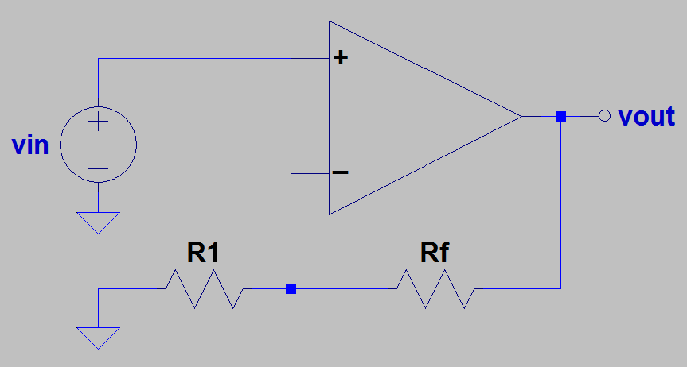
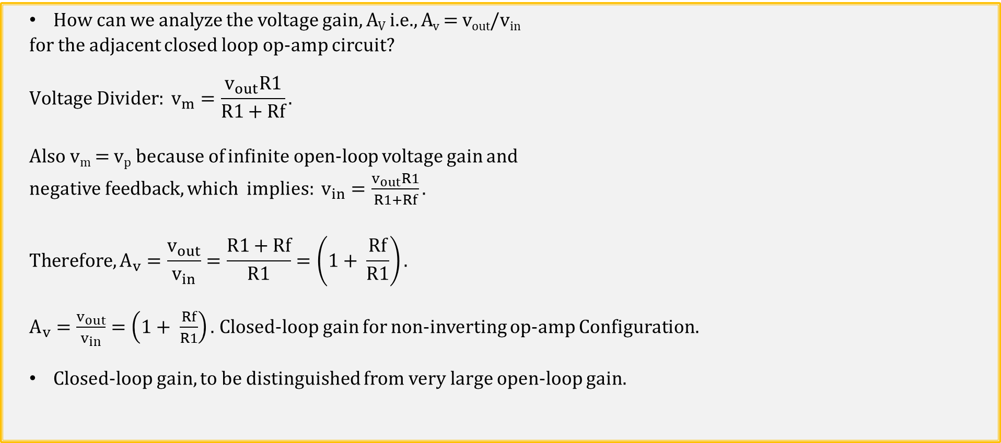
Non-Inverting Op-Amp Configuration
How can we analyze the voltage gain, A_{V} i.e., A_{v} = v_{out}/v_{in}
for the adjacent closed loop op-amp circuit?
$$Voltage Divider: v_{m}=\frac{v_{out}R1}{R1+Rf}.$$
Also v_{m} = v_{p} because of infinite open-loop voltage gain and
negative feedback, which implies: $v_{in}=\frac{v_{out}R1}{R1+Rf}.$
$$Therefore, A_{v}=\frac{v_{out}}{v_{in}}=\frac{R1+Rf}{R1}=\left(1+ \frac{Rf}{R1}\right).$$
$A_{v}=\frac{v_{out}}{v_{in}}=\left(1+ \frac{Rf}{R1}\right).$Closed-loop gain for non-inverting op-amp Configuration.
Closed-loop gain, to be distinguished from very large open-loop gain.
v_{p}
v_{m}

Slide 14
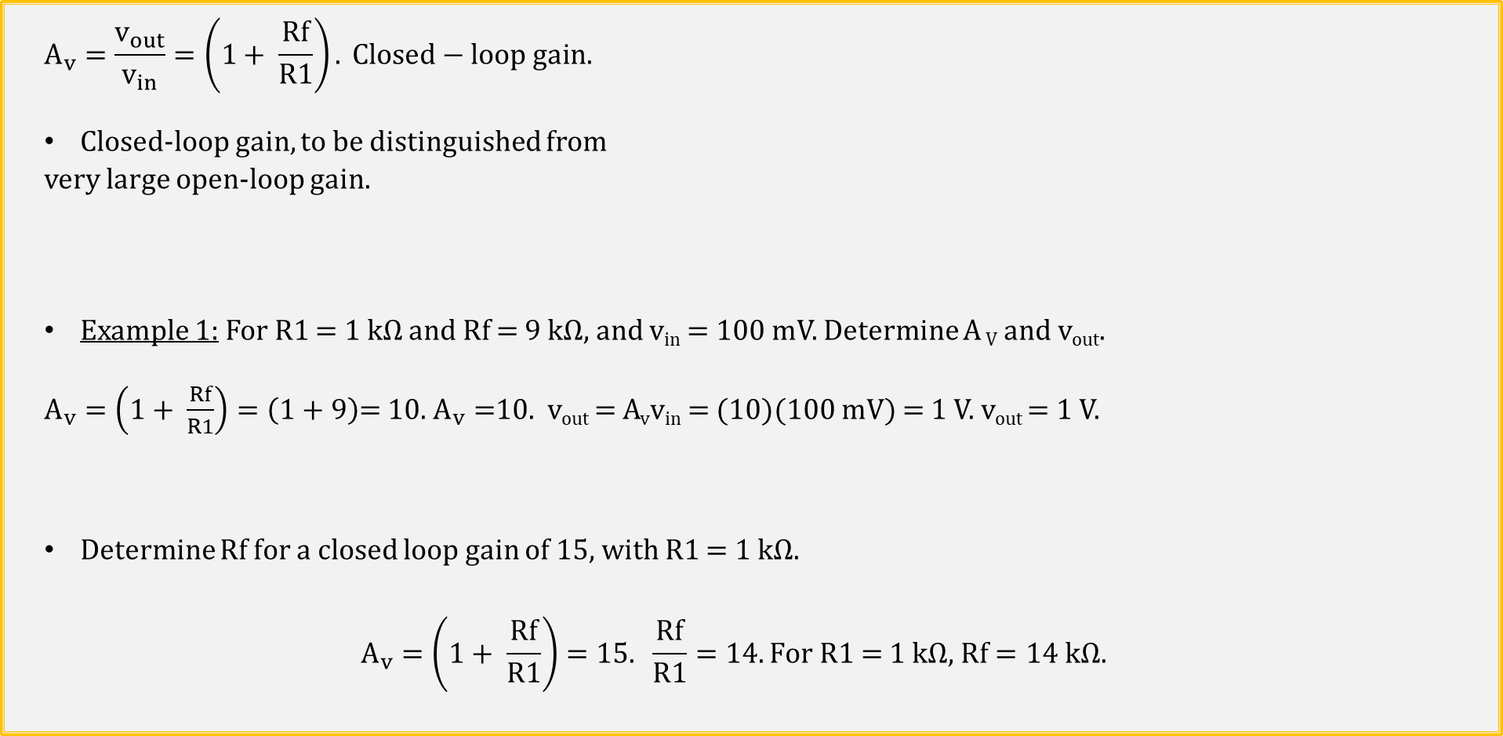
Non-Inverting Op-Amp Configuration (Continued)
$$A_{v}=\frac{v_{out}}{v_{in}}=\left(1+ \frac{Rf}{R1}\right). Closed−loop gain.$$
Closed-loop gain, to be distinguished from
very large open-loop gain.
Example 1: For R1 = 1 kΩ and Rf = 9 kΩ, and v_{in} = 100 mV. Determine A _{V} and v_{out}.
$A_{v}=\left(1+ \frac{Rf}{R1}\right)=\left(1+9\right)$= 10. $A_{v}=$10. v_{out} = A_{v}v_{in} = (10)(100 mV) = 1 V. v_{out} = 1 V.
Determine Rf for a closed loop gain of 15, with R1 = 1 kΩ.
$$A_{v}=\left(1+ \frac{Rf}{R1}\right)=15. \frac{Rf}{R1}=14. For \text{R}\text{1 = 1 }\text{k}\text{Ω}\text{, }Rf=14 kΩ.$$
v_{p}
v_{m}

Slide 15
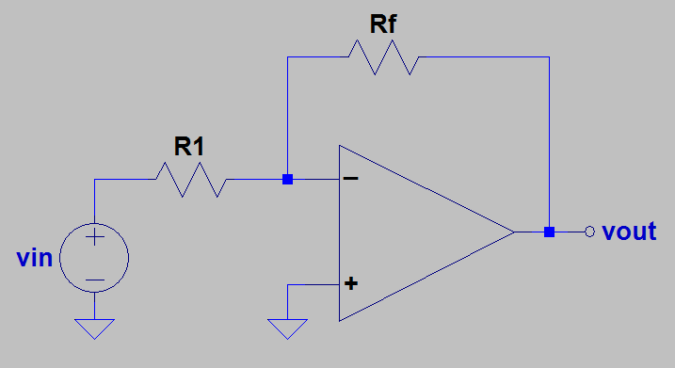
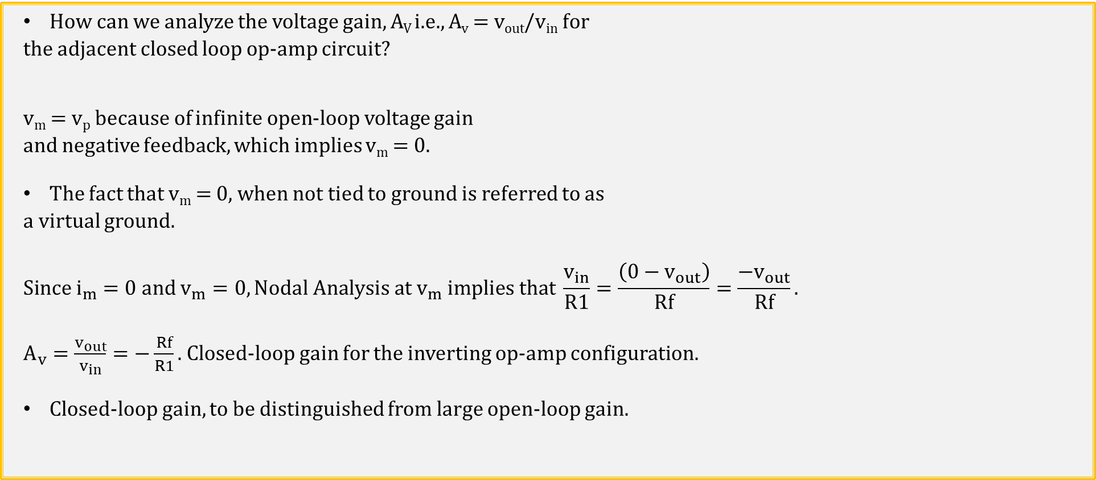
Inverting Op-Amp Configuration
How can we analyze the voltage gain, A_{V} i.e., A_{v} = v_{out}/v_{in} for
the adjacent closed loop op-amp circuit?
v_{m} = v_{p} because of infinite open-loop voltage gain
and negative feedback, which implies v_{m} = 0.
The fact that v_{m} = 0, when not tied to ground is referred to as
a virtual ground.
$$Since i_{m}=0 and v_{m}=0, Nodal Analysis at v_{m} implies that \frac{v_{in}}{R1}=\frac{\left(0−v_{out}\right)}{Rf}=\frac{−v_{out}}{Rf}.$$
$A_{v}=\frac{v_{out}}{v_{in}}=−\frac{Rf}{R1}.$Closed-loop gain for the inverting op-amp configuration.
Closed-loop gain, to be distinguished from large open-loop gain.
v_{m}
v_{p}

Slide 16
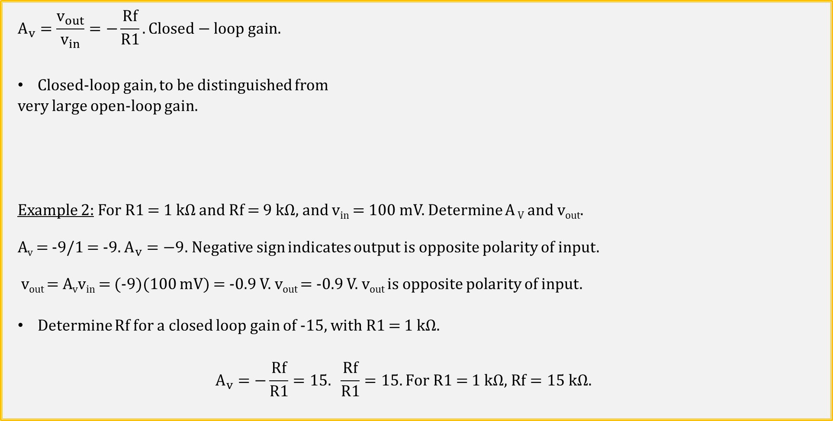
Inverting Op-Amp Configuration
$$A_{v}=\frac{v_{out}}{v_{in}}=−\frac{Rf}{R1}. Closed−loop gain.$$
Closed-loop gain, to be distinguished from
very large open-loop gain.
Example 2: For R1 = 1 kΩ and Rf = 9 kΩ, and v_{in} = 100 mV. Determine A _{V} and v_{out}.
A_{v} = -9/1 = -9. $A_{v}=−9$. Negative sign indicates output is opposite polarity of input.
v_{out} = A_{v}v_{in} = (-9)(100 mV) = -0.9 V. v_{out} = -0.9 V. v_{out} is opposite polarity of input.
Determine Rf for a closed loop gain of -15, with R1 = 1 kΩ.
$$A_{v}=−\frac{Rf}{R1}=15. \frac{Rf}{R1}=15. For \text{R}\text{1 = 1 }\text{k}\text{Ω}\text{, }Rf=15 kΩ.$$
v_{m}
v_{p}

Slide 17
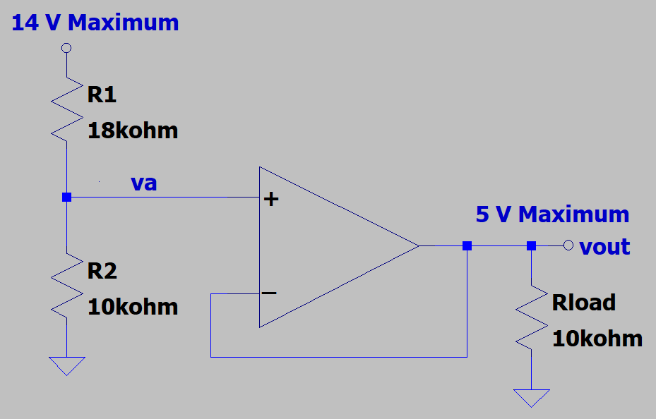
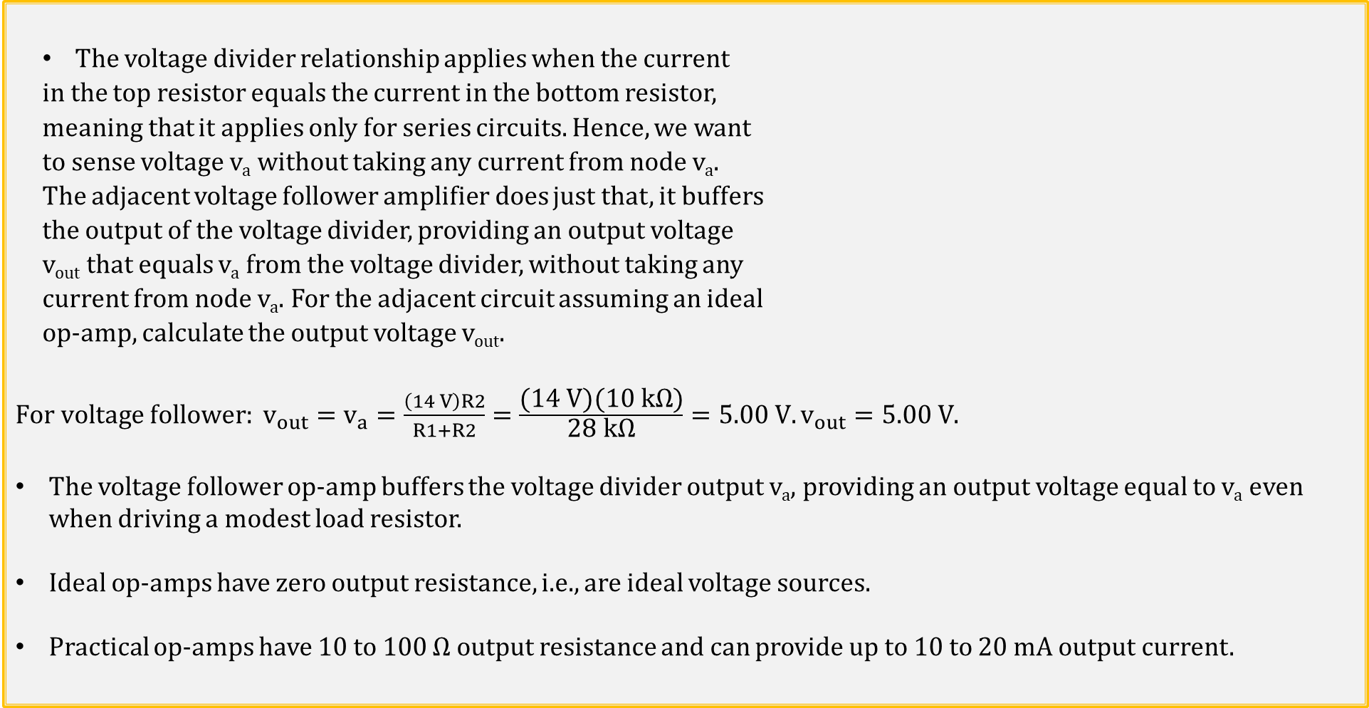
Voltage Follower Application
The voltage divider relationship applies when the current
in the top resistor equals the current in the bottom resistor,
meaning that it applies only for series circuits. Hence, we want
to sense voltage v_{a} without taking any current from node v_{a}.
The adjacent voltage follower amplifier does just that, it buffers
the output of the voltage divider, providing an output voltage
v_{out} that equals v_{a} from the voltage divider, without taking any
current from node v_{a}. For the adjacent circuit assuming an ideal
op-amp, calculate the output voltage v_{out}.
$For voltage follower: v_{out}=v_{a}=\frac{\left(14 V\right)R2}{R1+R2}=\frac{\text{(}\text{14} \text{V}\text{)(10 }\text{k}\text{Ω)}}{\text{28} \text{k}\text{Ω}}=5.00 V.v_{out}=5.00 V$.
The voltage follower op-amp buffers the voltage divider output v_{a}, providing an output voltage equal to v_{a} even when driving a modest load resistor.
Ideal op-amps have zero output resistance, i.e., are ideal voltage sources.
Practical op-amps have 10 to 100 Ω output resistance and can provide up to 10 to 20 mA output current.

Slide 18
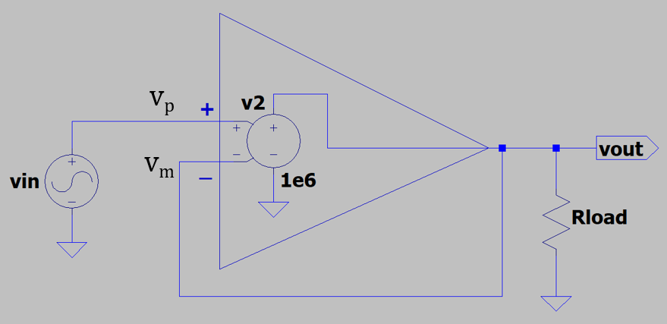
Practical Voltage Follower
For an ideal op-amp v_{p} = v_{m}, and for v_{in} = 1.00 V, v_{out} = 1.00 V for the
voltage follower configuration.
Yet if v_{p} = v_{m}, and v_{p} – v_{m} = 0 V, then doesn’t v_{out} = A_{V}(v_{p} – v_{m} ) = 0?
Mathematically, v_{out} = (∞)(0 V) is indeterminate for an ideal op-amp.
Practical op-amps have open-loop gains < ∞, resulting in v_{p} – v_{m} not exactly equal to 0 V.
For example, given an open loop gain A_{V} = 1 x 10⁶, and v_{p} = v_{in} = 1.00 V, v_{out} = v_{m} ≈ 1.00 V.
In the above circuit, since v_{out} = A_{V}(v_{p} – v_{m} ) = (1 x 10⁶)(v_{p} – v_{m} ) ≈ 1.00 V, with (1.00 V)/(1 x 10⁶) = 1 µV. Therefore, v_{p} – v_{m} ≈ 1 µV instead of 0 µV for v_{out} ≈ 1.00 V. v_{out} = v_{m} = 1.00 V - 1 µV = 0.999999 V instead of 1.00 V.
So for the above voltage follower with an open loop gain A_{V} = 1 x 10⁶, and v_{p} = v_{in} = 1.00 V, v_{out} = v_{m} = 1.00 V - 1 µV = 0.999999 V, which is close enough to 1.00 V for practical applications.
A large open-loop gain and negative feedback associated with op-amps result in v_{p} ≈ v_{m} , which for hand calculations is well approximated as v_{p} = v_{m}.

Slide 19
The End

Slide 20
Extra

Slide 21
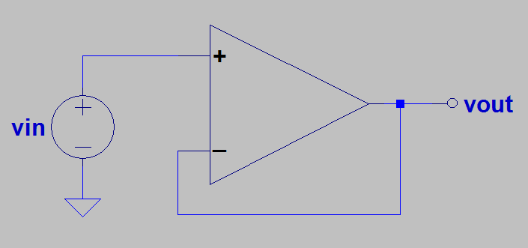
Feedback Control
Feedback control:
Use negative feedback (negative because output is connected to minus input) to minimize the difference between the desired output voltage and the actual output voltage.
Hot
Feedback control:
Use negative (balancing) feedback to minimize the difference between the desired water temperature and the actual water temperature.
v_{p}
v_{m}
Cold
Poll Questions.

